Slide 1
Eye and AI
Recent researches with a focus on Dry Eye

Slide 2
Previous research focus
Medical diagnosis
Diabetic Retinopathy
Glaucoma
Cataract
Myopia Prediction
Retinopathy of prematurity (ROP)
Age-related Macular Degeneration (AMD)
Eye Tracking

Slide 3
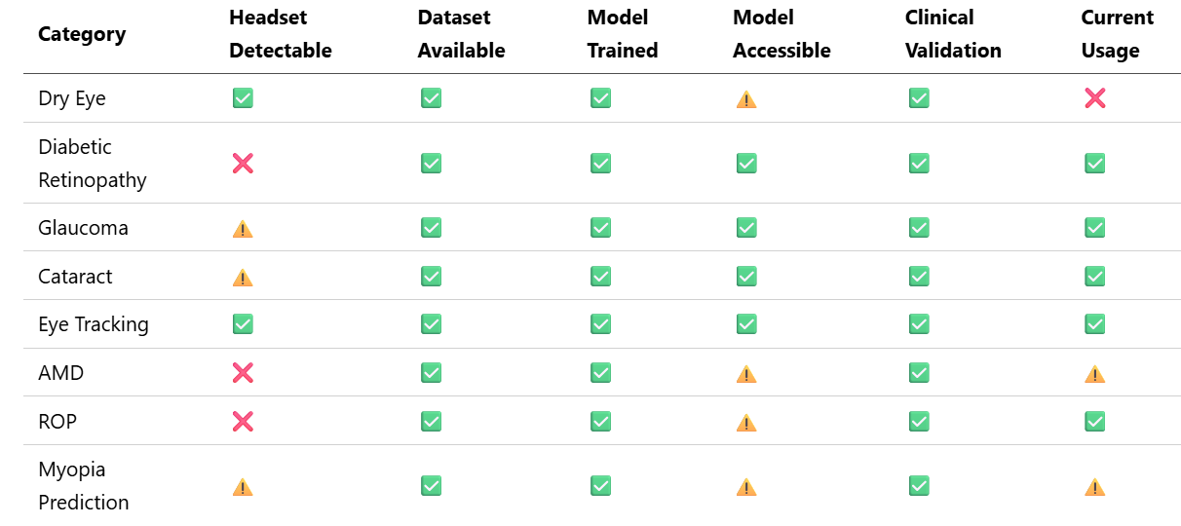
Summary table

Slide 4
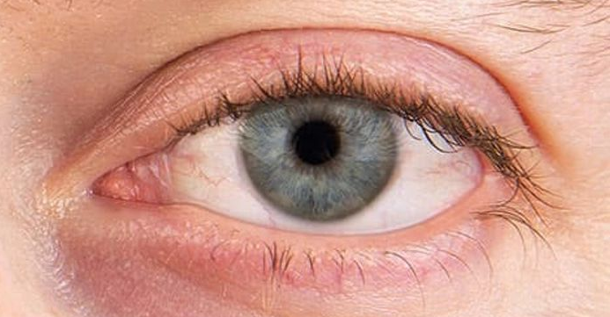
Dry eye – Detectable symptoms
Ocular surface morphology
Tear film breakup
patterns
Blink pattern and
frequency
Meibomian gland
structure and drop out
Tear meniscus height
and area

Slide 5
Required equipments and technologies
Near-eye RGB/IR Cameras for capturing ocular surface and tear meniscus (already present)
Video recording capability for capturing blink and tear film breakup patterns
Infrared illuminations for meibomian gland imaging (should be easy to implement by adding IR-LEDs)

